Slide 1

BANK LOAN CASE STUDY
By Drustant Metar

Slide 2
Project description
A finance company that specializes in lending various types of loans to urban customers.
The company faces a challenge: some customers who don't have a sufficient credit history take advantage of this and default on their loans.
Our task is to use exploratory data analysis (EDA) to analyze patterns in the Data and ensure that capable applicants are not rejected.
When a customer applies for a loan, your company faces two risks:
If the applicant can repay the loan but is not approved, the company loses business.
If the applicant cannot repay the loan and is approved, the company faces a financial loss.

Slide 3
Customers with payment difficulties:
These are customers who had a late payment of more than X days on at least one of the first Y installments of the loan.
All other cases: These are cases where the payment was made on time.
When a customer applies for a loan, there are four possible outcomes:
Approved: The company has approved the loan application.
Cancelled: The customer cancelled the application during the approval process.
Refused: The company rejected the loan.
Unused Offer: The loan was approved but the customer did not use it.
The aim in this project is to use EDA to understand how customer attributes and loan attributes influence the likelihood of default.

Slide 4
approach
Our collection contains tables with a wealth of information about bank loans. We thoroughly reviewed the dataset before executing a number of queries
to extract relevant data from it.
Find out the null values, blank values empty values and clean it.
Use filter, pivot table, and other functions to give answer of asked questions.
To make a proper solution and meaningful data representation.

Slide 5
Tech-stack used
I used the following tools for complete my analysis
Google drive
Microsoft Excel for analysis
Microsoft Power point

Slide 6
insights
Default Risk Identification: Analyze the characteristics of customers who defaulted on their loans, such as demographics, employment status, income level, and credit history. This can help identify high-risk applicants who are more likely to default on their loans.
Payment Behavior Patterns: Explore patterns in payment behavior, including frequency and severity of late payments. Identify any trends or correlations between late payments and other customer attributes, loan types, or loan terms.
Impact of Credit History: Examine the relationship between the length and completeness of a customer's credit history and their likelihood of default. Customers with limited or negative credit history may pose a higher risk.
Loan Approval Decisions: Investigate reasons for loan approvals and rejections. Identify any biases or inconsistencies in the approval process that may lead to capable applicants being rejected or risky applicants being approved.

Slide 7

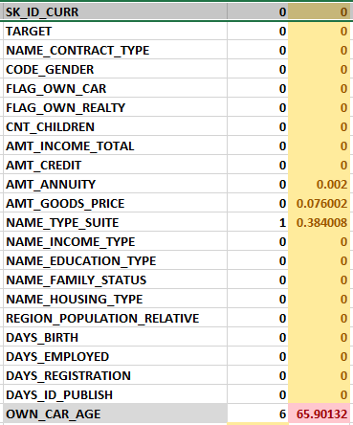
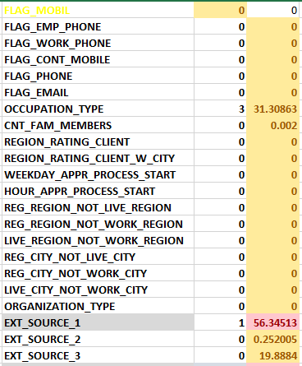
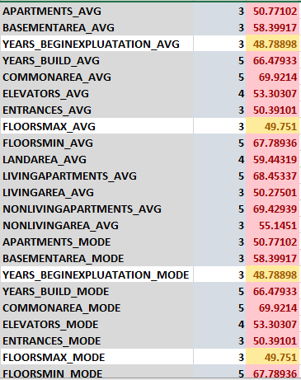
Task 1: Identify Missing Data and Deal with it Appropriately
Task: Identify the missing data in the dataset and decide on an appropriate method to deal with it using Excel built-in functions and features.

Slide 8
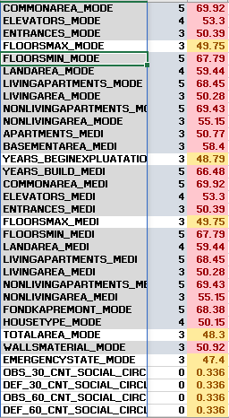
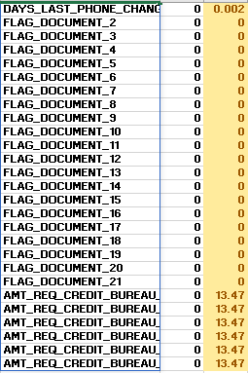

Slide 9
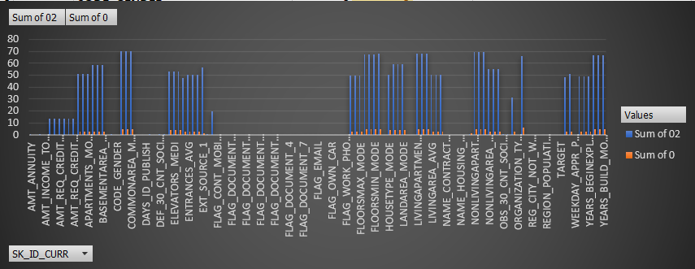

Slide 10
Output:
The original dataset included 50000 rows and 125 columns, many of which had missing values.
The count of the missing values in each column was obtained by using the countblank function, which gave rise to a preliminary comprehension of the data's integrity.
The percentage of missing values in each column was determined since it was recognized that he absolute count of missing values would not be appropriate for analysis.
Missing values proportion:
If A column has fewer than 50% missing values, imputation was done using average or median values for the numerical values in that column.
If a column has more than 50% missing values. It was determined that it was not required to include it in the dataset.
Formulas:
It count the blank values of the data set
=COUNTBLANK(A49995:A50000)
It counts the blank values proportion in the form of percentage
=(COUNTBLANK(A2:A50000)/COUNT($A$2:$A$50000))*100

Slide 11
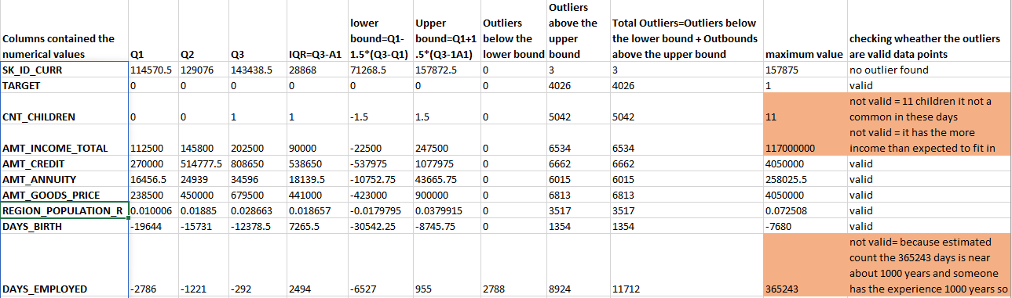
Task 2: identify outliers in the dataset
Task: Detect and identify outliers in the dataset using Excel statistical functions and features, focusing on numerical variables.
The analysis done to find outliers is displayed in the table below:

Slide 12
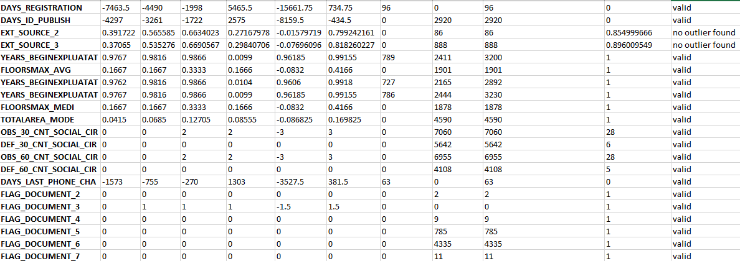

Slide 13
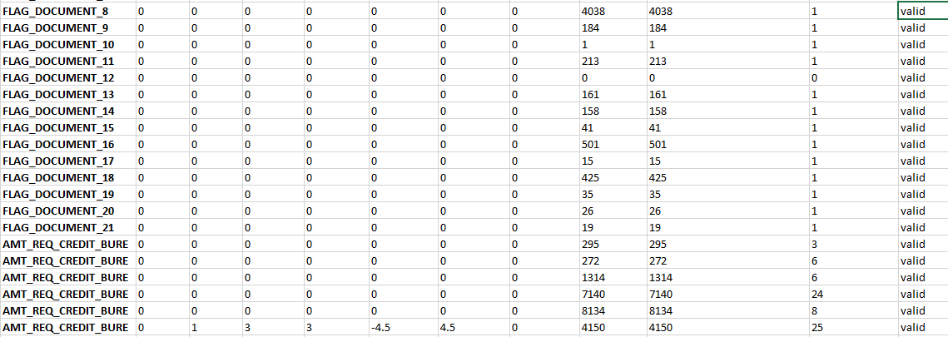

Slide 14
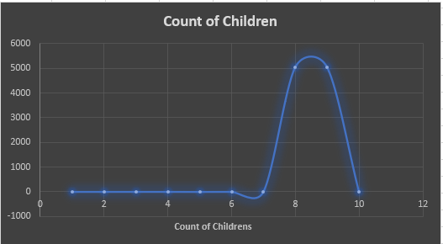
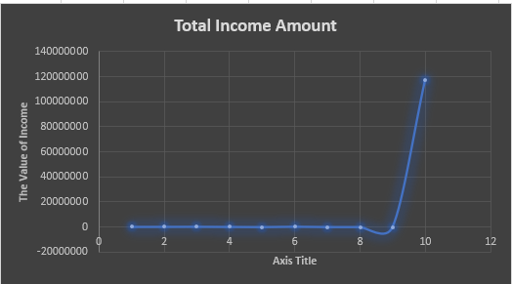
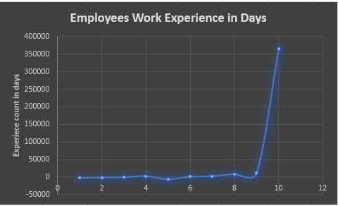

Slide 15
FORMULAS:
Quartile 1: =QUARTILE(B2:B50000,1)
Quartile 2: =QUARTILE(B2:B50000,2)
Quartile 3: =QUARTILE(B2:B50000,3)
IQR=Q3-Q1
lower bound=Q1-1.5*(Q3-Q1)
Upper bound=Q1+1.5*(Q3-1A1)
Outliers below the lower bound: =COUNTIF(B2:B50000,"<"&B50008)
Outliers above the upper bound: =COUNTIF(B2:B50000,">"&B50009)
Total Outliers=Outliers below the lower bound + Outbounds above the upper bound:
maximum value: =MAX()

Slide 16

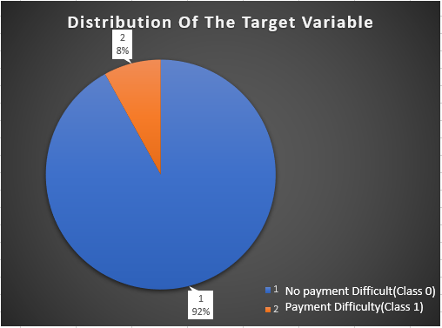
TASK 3: Analyze Data Imbalance
Task: Determine if there is data imbalance in the loan application dataset and calculate the ratio of data imbalance using Excel functions.
Formulas:
This formula calculate the no payment difficulty(Class 0)
=COUNTIF(A:A,0)
This formula calculate the no payment difficulty(Class 1)
=COUNTIF(A:A,1)
This formula calculate the ration of the imbalance data
=B2/C2

Slide 17
Task 4:Perform Univariate, Segmented Univariate, and Bivariate Analysis
Task: Perform univariate analysis to understand the distribution of individual variables, segmented univariate analysis to compare variable distributions for different scenarios, and bivariate analysis to explore relationships between variables and the target variable using Excel functions and features.
Univariate Analysis: Univariate Analysis Summarize Only One Variable At A Time.
e.g. APPLICANTS PER CREDIT BINS and NAME-TYPE-SUITE
Segmented Univariate: Segment the categorical variable and then perform univariate analysis across its categorical.
e.g. TARGET APPLICANTS PER INCOME BINS
Bivariate Analysis: Bivariate statistics compare two variables.
e.g. AVERAGE CREDIT AMOUNT PER INCOME BINS

Slide 18
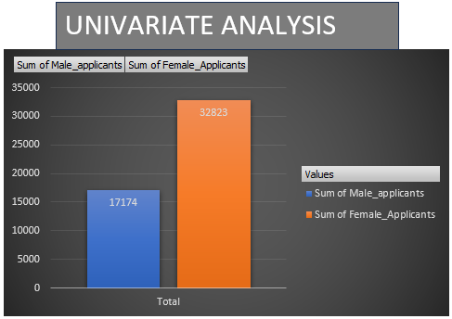
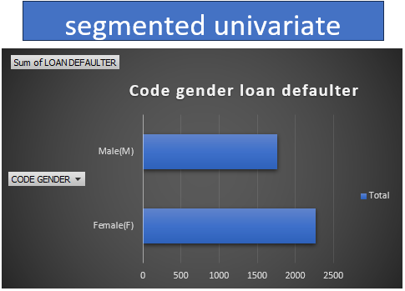



Slide 19
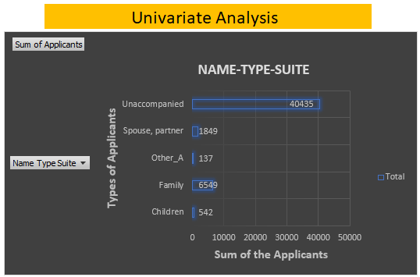
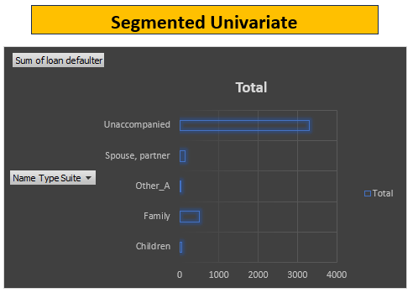
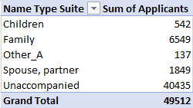
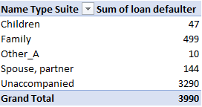

Slide 20
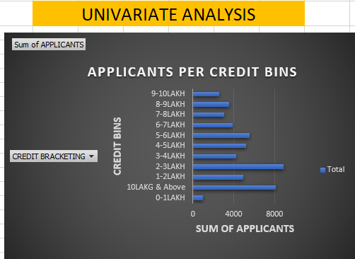
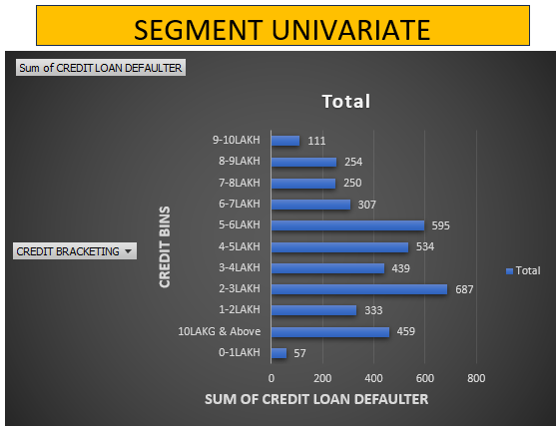
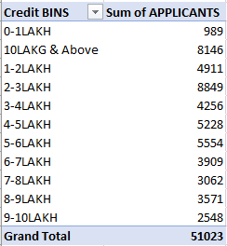
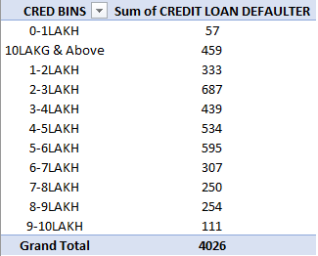

Slide 21
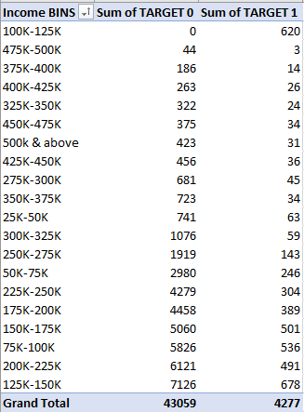
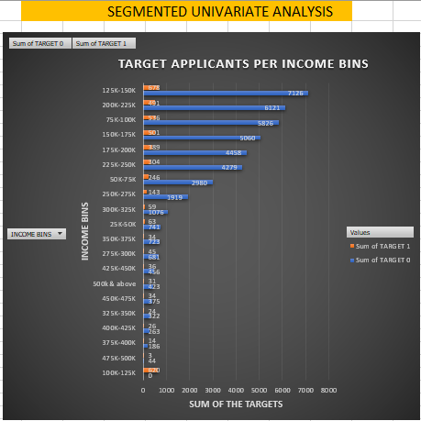

Slide 22
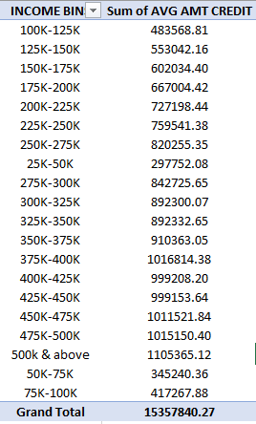
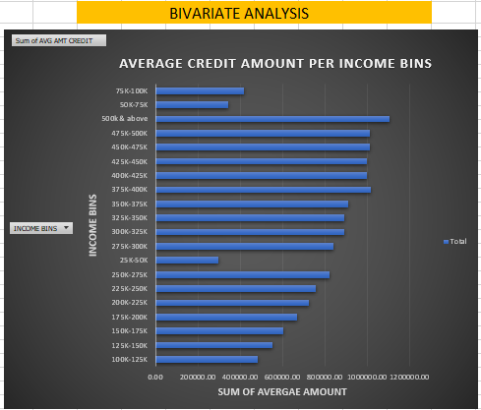

Slide 23
Output:
A through grasp of each variable's properties was made possible via univariate analysis.
2. which was crucial for locating possible predictors of loan default. compared variable distributions for several scenarios using segmented univariate analysis technique.
3. the study employed bivariate analysis to investigate correlation between the a target variable and other factors.
Formulas:
Calculate the maximum/minimum value from specified column
=MAX(AQ:AQ) =MIN(AQ:AQ)
Calculate the days in years =ROUND(AP2/365.25,0)
It helps to count loan defaulter the values from the specified conditions
=COUNTIFS(AQ:AQ,">=20",AQ:AQ,"<=25",B:B,1)/COUNTIFS(AQ:AQ,">=20",AQ:AQ,"<=25")*100
Count the average of the observation with the help of specified condition
=AVERAGEIFS(Z:Z,M:M,">=25000",M:M,"<=50000")

Slide 24
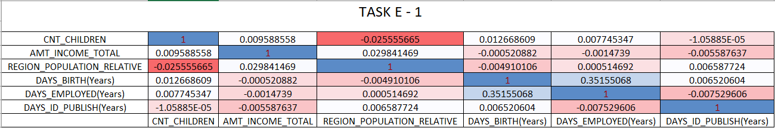

Task 5: Identify Top Correlations for Different Scenarios
Task: Segment the dataset based on different scenarios (e.g., clients with payment difficulties and all other cases) and identify the top correlations for each segmented data using Excel functions.
Top correlation among loan applicants who meet the payment criteria
Top correlation among loan applicants who fail to meet payment criteria

Slide 25
result
This case study provided useful insights on data analysis in datasets that include loan application data.
I carefully looked at how to handle missing data, identify outliers, and analyze data imbalances using Excel's features and capabilities.
I carefully examined the relationships between various attributes and loan default, studying the dataset to create a complex graph of the variables impacting loan default. Decision-making in the loan sector and risk assessment depend on this knowledge.
This project has also demonstrated the benefits of using data-driven strategies to expedite the loan approval process and lower default risks.
With my improved ability to navigate complex circumstances and obtain insightful knowledge to increase decision-making across a range of industries.

Slide 26
Drive link
Excel link: https://docs.google.com/spreadsheets/d/1WJSKwJqTFgjvIIE48ajWIIbPAOgZaY34/edit?usp=drive_link&ouid=110876986073115360474&rtpof=true&sd=true

Slide 27
Thank you !!!

